Slide 1
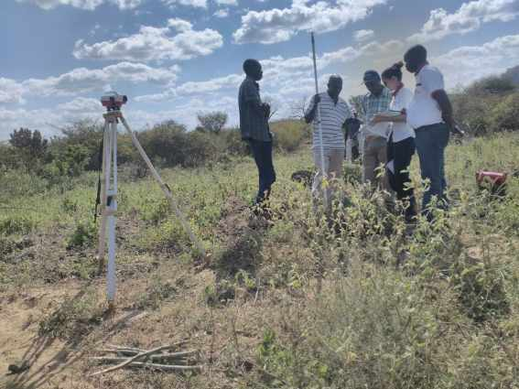
SETTING OUT
OF THE DTF MODULES

Slide 2
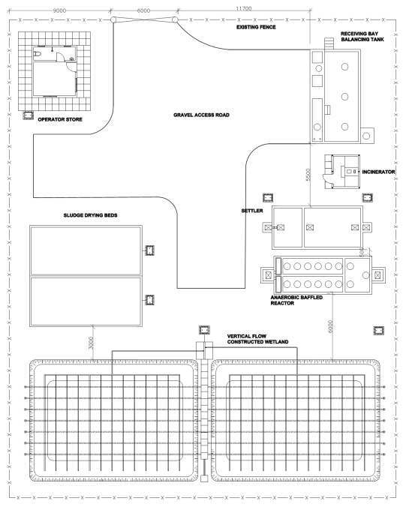
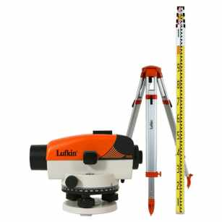
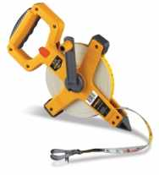
LAYOUT PLAN

Slide 3
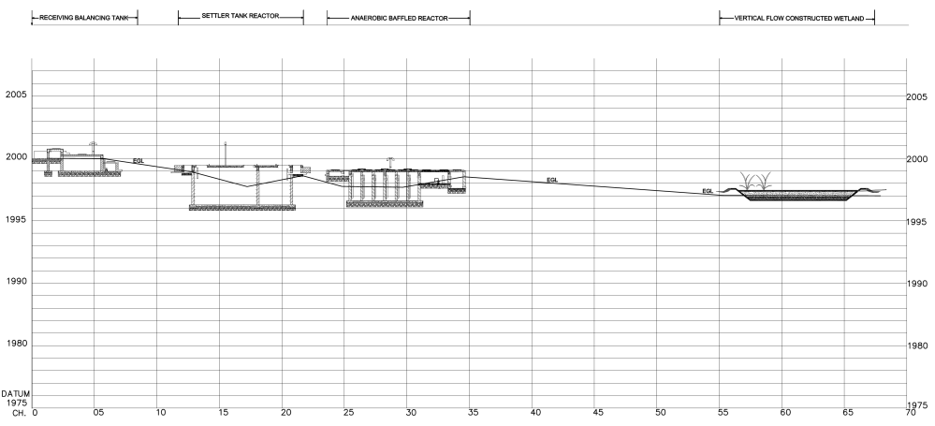
LONGITUDINAL PROFILE
< 1%
< 1%
< 10%
Δ 0.8m
Δ 0.1m
Δ 1m
Δ 0.6m

Slide 4
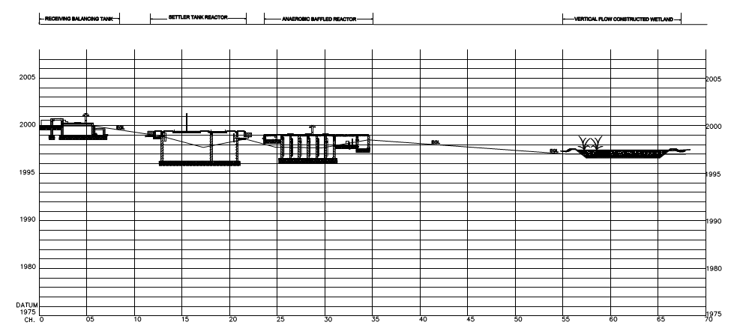
LEVELS
< 1%
< 1%
< 10%
Δ 0.8m
Δ 0.1m
Δ 1m
Δ 0.6m
Module inlet | Distances [m] | Minimum level difference [m]
Inlet RBBT and Inlet Settler
Inlet Settler and inlet ABR
Inlet ABR and Inlet VFCW
Inlet VFCW and Water body
5
1
20
450
0.8 + 0.05 = 0.85
1 + 0.1 = 1.1
1 + 0.2 = 1.2
4.5

Slide 5
PROCEDURE (in the case of Oloolaiser DTF)
Mark the position of the first module RBBT with pegs (on the 4 corners), using the distances from the layout plan
Mark the position of the Settler using the distances from the layout plan and double checking the expected level from the longitudinal profile
Same way: mark the position of the ABR (distances double checked with levels)
Same way mark the position of the VFCW (distances double checked with levels)
Mark the position of the SDB, the Operator Store and the incinerator using the layout plan (levels not as important as with the rest of the modules)
Remember: the BoQ has been done according to the initial setting out. Changing the setting out might lead to a variation in costs (excavation)

